Slide 1

Housing Price at Toronto Area
Presented by: Yi-hong, Chen

Slide 2
Motivation
The growth of population at Toronto
Intend to buy estates – accessing information of nearby
Investor – Determine whether the estates are worth to invest

Slide 3
Data Applying
Price of Estates
Web scraping from zoocasa.com which has tremendous posts
Coordinates
Nominatim of Geopy
Venues
Foursquare

Slide 4
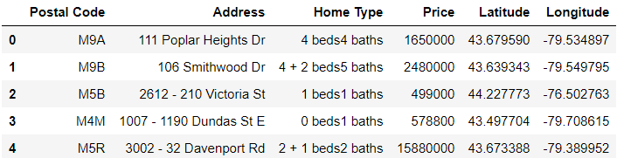
Price of Estates Dataframe Information
Tabel1. Applied price of estates dataframe in the project
Address, Home type, and Price were collected by web scraping
Accessed Postal Code and the coordinate through Address

Slide 5
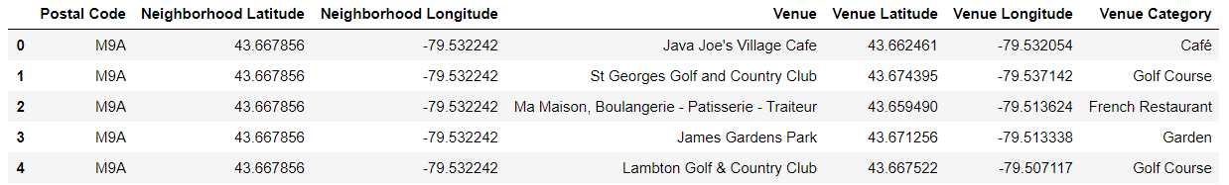
Venues Dataframe information
Tabel2. Applied venues dataframe in the project
Having information of Postal code and coordinate
Cluster of each postal code area in K-mean
The cluster is determined by the most common venue categories

Slide 6
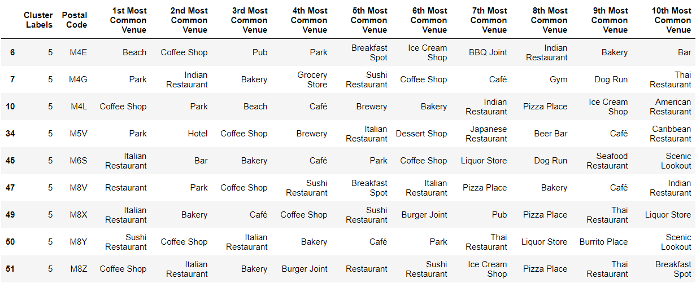
The Decision of Cluster
Tabel1. Chosen cluster dataframe in the project
Most common Venues in the cluster are attracting me

Slide 7
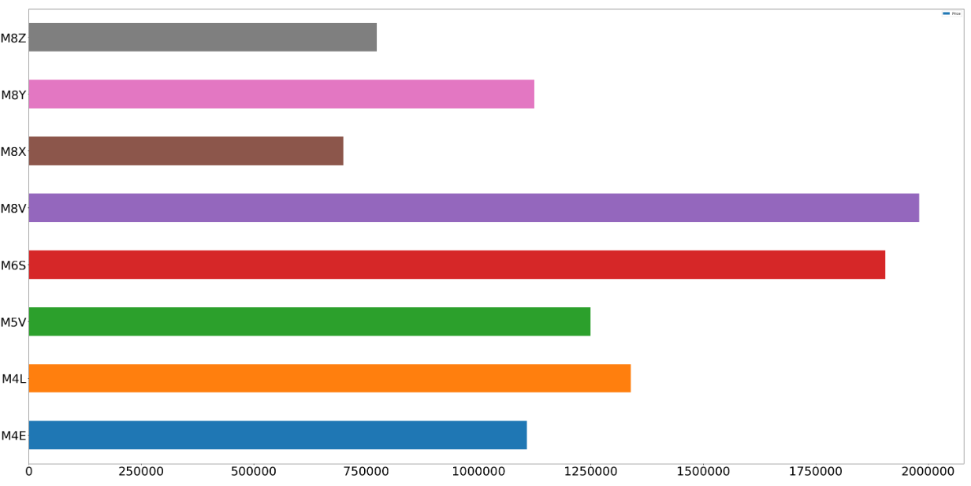
Median Price
Figure1. Median price of each postal code area in the cluster
Most postal code area prices are under my budget (120,000)
Next: List all houses under my budget

Slide 8
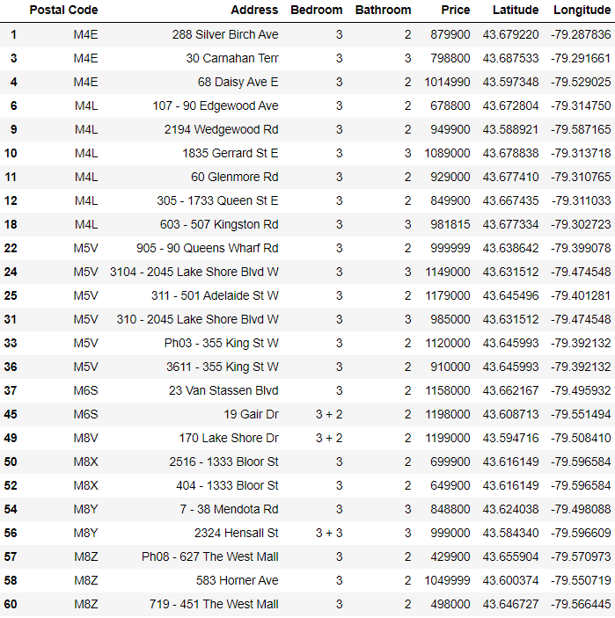
List of houses
Benefits
Acquire further information from this lists
Avoid to spent bunch of time on selecting suitable area from the websites

Slide 9
Future goals
Create bigger database of estates price
Add more information in the postal code area
Crime, Schools, Companies, etc.
Applying machine learning for future prices estimate

Slide 10
Thanks for your time

